Slide 1
Capstone Project I
Lending Club loan status prediction
Ye Peng Li

Slide 2
Introduction
Lending Club is a US peer-to-peer lending company, which operates an online lending platform that enables borrowers to obtain a loan, and investors to purchase notes backed by payments made on loans. Lending Club is the world's largest peer-to-peer lending platform. The company claims that $15.98 billion in loans had been originated through its platform up to December 31, 2015.
To find good borrowers is key for the investors in Lending Club to make profit. How to find a good borrowers? In other word, how to predict the loan status according to the information of the loan applicants? A predictive model of loan status can help the investors to make a wise decision for the loan applicants and decrease the risk of bad loans.

Slide 3
Data resource
Lending Club Data Set:
https://www.lendingclub.com/info/download-data.action
Local Area Unemployment Rate in US:
https://www.kaggle.com/jayrav13/unemployment-by-county-us
https://www.gaslampmedia.com/download-zip-code-latitude-longitude-city-state-county-csv/
https://github.com/liyepeng/Spring-Board-Data-Science- Track/blob/master/Lending%20Club%20project/Three_state_unemploy.csv

Slide 4
Target variable
The target variable in the project is loan status.
There are 7 types of loan status.
Among them 'Current', 'Fully Paid' and 'in grace period' mean that the lenders are paying the loan on time or have already paid the loan off. So these three status are called 'good loan'.
The rest four status mean the lenders have delayed the payment more than 15 days or even have no ability to make any payment at all. These four status are called 'bad loan'.

Slide 5
Data wrangling
a. Data wrangling of unemployment rate data sets 2015
changing states name to abbreviation
adding missing states unemployment information
making the counties' name match in both data a and data c
b. Data wrangling for lending club data set
1. Filling blank with 'NaN'.
2. Deleting blank columns, deleting post loan and hard ship variables.
4. Data format wrangling: get rid of '%',.
5. Feature engineering: There are more than 100000 categories for ‘emp_title’ variable. I choose top ten titles and create 10 dummy variables so it can be used in EDA and model building.

Slide 6
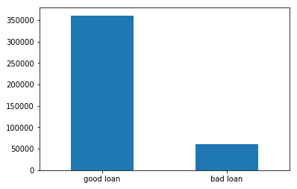
Explanatory Data Analysis
How many good loans and bad loans are there?

Slide 7
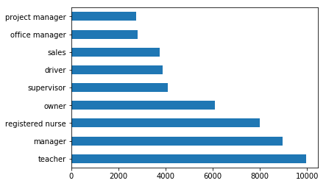
The loan amount and employment title

Slide 8
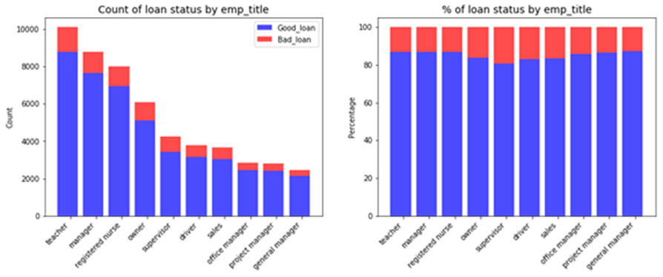
The bad loans for different occupations
Chi square test for the loan status and employment title
chi_squared_stat: 269.3 Critical value: 21.0260698175 P value: 0.0

Slide 9
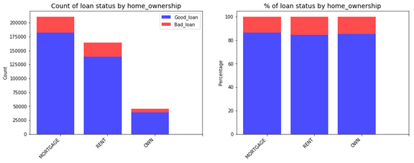
The relationship between loan status and home ownership
Chi square test for loan status and home ownership
chi_squared_stat: 1692.8 Critical value: 11.0704976935 P value: 0.0

Slide 10
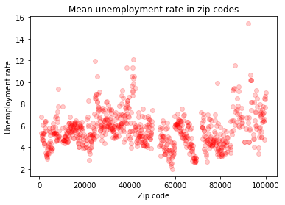
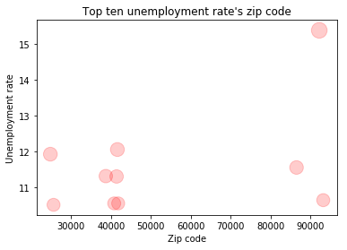
What is the mean unemployment rate in zip codes for bad/good loans?
The top ten unemployment rates locate in three zip codes area(20000, 40000, 90000).States CA and AZ's zip codes are around 90000, KY is around 40000, WV and MS are around 20000.

Slide 11
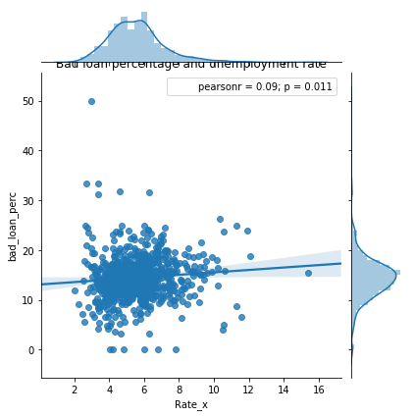
Will the loan lenders in the five states (CA, AZ, KY, WV and MS) which have high unemployment rates also have high bad loan percentage?

Slide 12
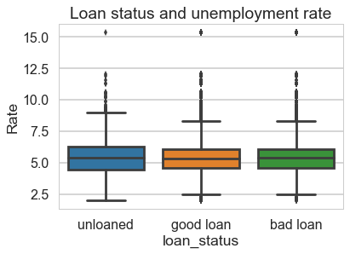
From the above figure we can see the mean unemployment rate for good loan lenders is lower than that of unloaded population and bad loan lenders. The mean calculation shows the mean unemployment rate for unloaded population is lower than that of bad loan lenders.
In other words, people that are accepted for a loan and pay back a loan on time typically more easily employed than the rest of the population. While people that are accepted for a loan and don't pay back a loan typically more likely to be unemployed than the rest of the population.

Slide 13
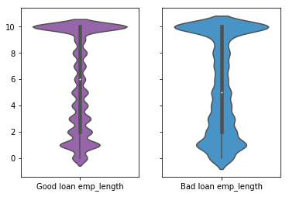
The relationship of employment length and bad loan percentage
Kruskal-Wallis H-test for the median of employment length of different loan status
The Kruskal-Wallis H-test tests the null hypothesis that the population median of all of the groups are equal. It is a non-parametric version of ANOVA. The test works on 2 or more independent samples, which may have different sizes. Note that rejecting the null hypothesis does not indicate which of the groups differs.
Test statistics:
Kruskal Wallis H-test test: H-statistic: 189435635.4 P-Value: 0.0

Slide 14
Model building
Decision Tree
Decision tree learning uses a decision tree (as a predictive model) to go from observations about an item (represented in the branches) to conclusions about the item's target value (represented in the leaves). Tree models where the target variable can take a discrete set of values are called classification trees.

Slide 15
Hyper parameter tuning for max depth
[(3, 0.85669108733167099), (4, 0.85671483517706548), (5, 0.85673066729330494), (6, 0.85673066729330494), (7, 0.85663567777590433), (8, 0.85623987914651389), (9, 0.85583221575084278)]
From the scores we obtained from the tuning process max_depth equaling 5 or 6 is the best choice.

Slide 16
Model score using ‘gini index’ and ‘entropy’
DecisionTreeClassifier(class_weight=None, criterion='gini', max_depth=6, max_features=None, max_leaf_nodes=None, min_impurity_decrease=0.0, min_impurity_split=None, min_samples_leaf=50, min_samples_split=2, min_weight_fraction_leaf=0.0, presort=False, random_state=0, splitter='best')
AUC - ROC gini : 0.636293062904
AUC - ROC entropy : 0.637417236881
The score of the model using 'entropy' is a little bit higher than that using 'gini index'.

Slide 17
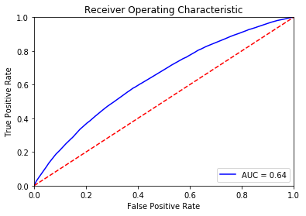
ROC_AUC Curve of Decision tree model

Slide 18
Model building
Random Forest
Random forest is an ensemble tool which takes a subset of observations and a subset of variables to build a decision trees. It builds multiple such decision tree and amalgamate them together to get a more accurate and stable prediction.

Slide 19
There are primarily 3 features which can be tuned to improve the predictive power of the model:
1. max_features:
2. n_estimators:
3. min_sample_leaf:
Features which will make the model training easier:
1. n_jobs:
2. oob_score:

Slide 20
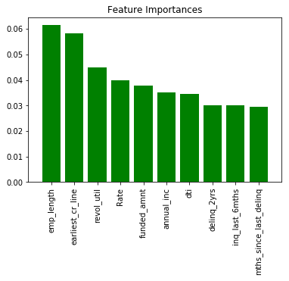
Compare the feature importance
1) emp_length 0.061432
2) earliest_cr_line 0.058367
3) revol_util 0.044979
4) Rate 0.040004
5) funded_amnt 0.037900
6) annual_inc 0.035266
7) dti 0.034621
8) delinq_2yrs 0.030147
9) inq_last_6mths 0.030045
10) mths_since_last_delinq 0.029514

Slide 21
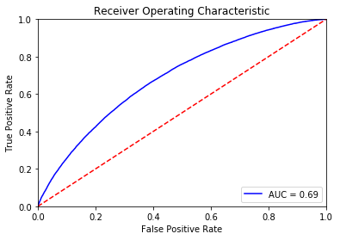
Score the random forest model and plot roc curve
AUC - ROC : 0.685429646528

Slide 22
Model building
Gradient Boosting Method
Gradient boosting is a machine learning technique for regression and classification problems, which produces a prediction model in the form of an ensemble of weak prediction models, typically decision trees. It builds the model in a stage-wise fashion like other boosting methods do, and it generalizes them by allowing optimization of an arbitrary differentiable loss function.

Slide 23
Let’s consider the important GBM parameters used to improve model performance in Python:
1. learning_rate
Lower values are generally preferred as they make the model robust to the specific
characteristics of tree and thus allowing it to generalize well. Lower values would require higher number of trees to model all the relations and will be computationally expensive.
2. n_estimators
The number of sequential trees to be modeled. Though GBM is fairly robust at higher number of trees but it can still over fit at a point. Hence, this should be tuned using CV for a particular learning rate.
3. subsample
The fraction of observations to be selected for each tree. Selection is done by random sampling. Values slightly less than 1 make the model robust by reducing the variance. Typical values ~0.8 generally work fine but can be fine-tuned further.

Slide 24
Tuning the learning rate
learning rate 0.0001 mean scores: 0.856691087231
learning rate 0.001 mean scores: 0.856691087231
learning rate 0.005 mean scores: 0.856691087231
learning rate 0.01 mean scores: 0.856691087231
learning rate 0.05 mean scores: 0.856885026801
learning rate 0.1 mean scores: 0.85705917701

Slide 25
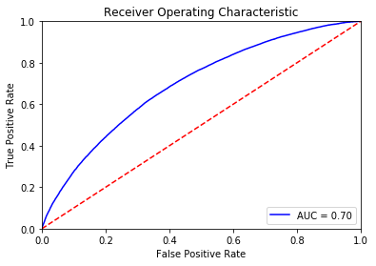
Scoring the GBM model
AUC - ROC : 0.695163508282

Slide 26
To predict the loan status we tried Decision Tree, Random Forest and Gradient Boost method. We tuned hyper parameters and used cross validation. Finally we increase the ROC_AUC score from 0.64 to 0.70. Gradient Boost method proved to be the best method for the predictive model.

Slide 27
There is still room for the improvement of model performance, however. In the EDA and statistical part we analyzed four features which are employment length, unemployment rate, employment title and home ownership. They all have impacts on the bad loan ratio and statistical testing shows the impact has statistical significance.

Slide 28
But from the feather importance analysis we can only see the employment length and unemployment rate are among the top ten important features. The employment title's importance is zero. It is worth to dig deeper for the feature "employment title". For example we can explore more than 10 employment titles and see if it will increase the importance of the feature. Or we can connect employment title with employment length and create a new variable, because the income for a teacher working for ten years will have great difference with a manager working for ten years.

